Slide 1
Enriching Word Vectors with Subword Information
Neural Networks
Ibis Prevedello

Slide 2
Outline
Currently problems
Authors proposal
Model
Subword model
Results
PCA

Slide 3
Current problems
Current models ignore morphology of words
Limitation for large vocabularies and rare words

Slide 4
Authors proposal
Based on skipgram model
Represent each word as a bag of character n-grams
Words are represented as the sum of the n-grams
Allows to compute word representation for words not in training data

Slide 5
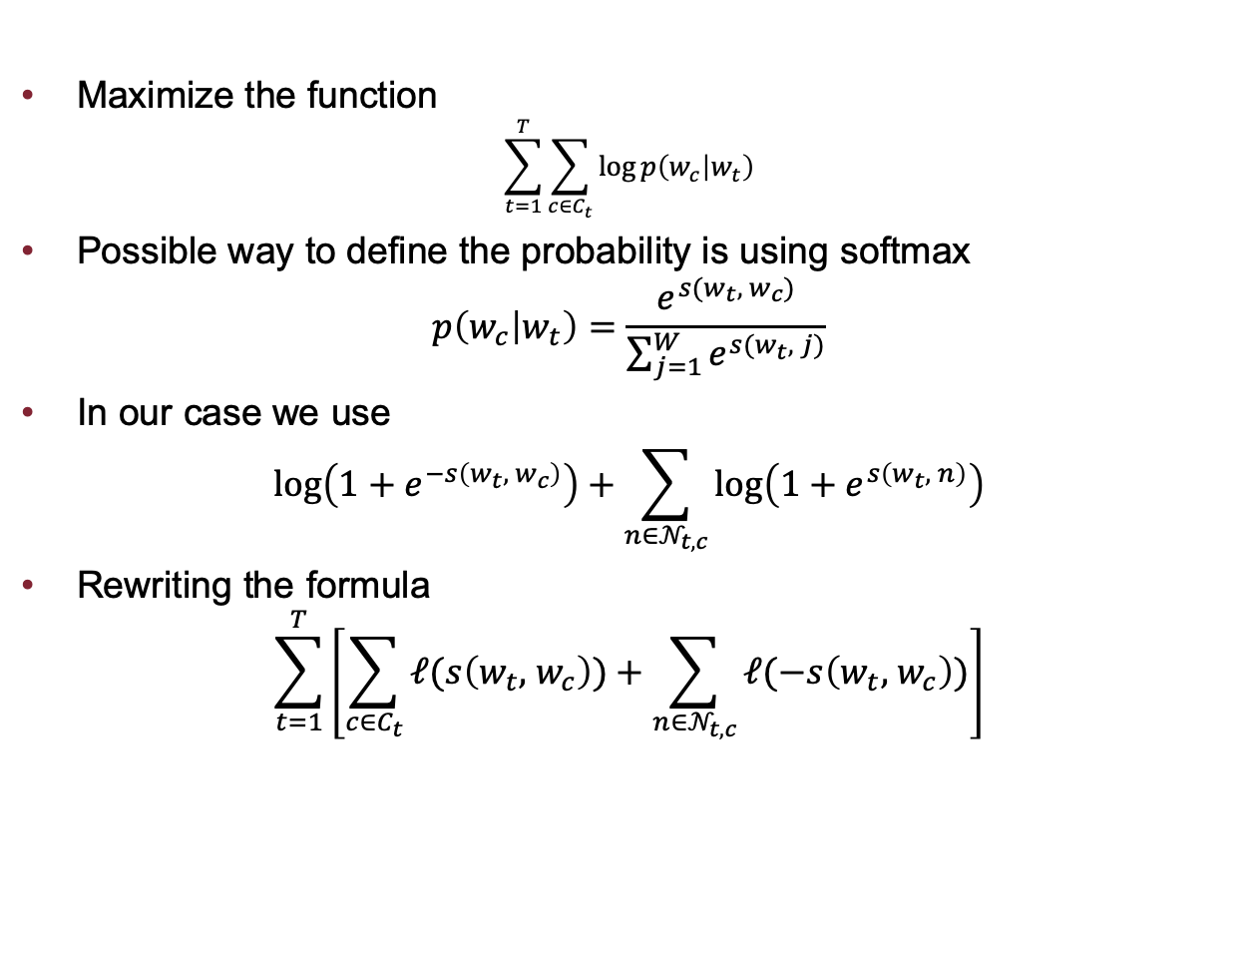
Model
Maximize the function
$$\sum_{t=1}^{T}{\sum_{c∈C_{t}}{\log{p\left(w_{c} | w_{t}\right)}}}$$
Possible way to define the probability is using softmax
$$p\left(w_{c} | w_{t}\right)=\frac{e^{s(w_{t},{ w}_{c})}}{\sum_{j=1}^{W}{e^{s(w_{t}, j)}}}$$
In our case we use
$$\log\left(1+e^{−s\left(w_{t},{ w}_{c}\right)}\right)+\sum_{n∈𝒩_{t,c}}{\log\left(1+e^{s\left(w_{t}, n\right)}\right)}$$
Rewriting the formula
$$\sum_{t=1}^{T}{\left[\sum_{c∈C_{t}}{ℓ(s\left(w_{t},{ w}_{c}\right))+\sum_{n∈𝒩_{t,c}}{ℓ(−s\left(w_{t},{ w}_{c}\right))}}\right]}$$

Slide 6
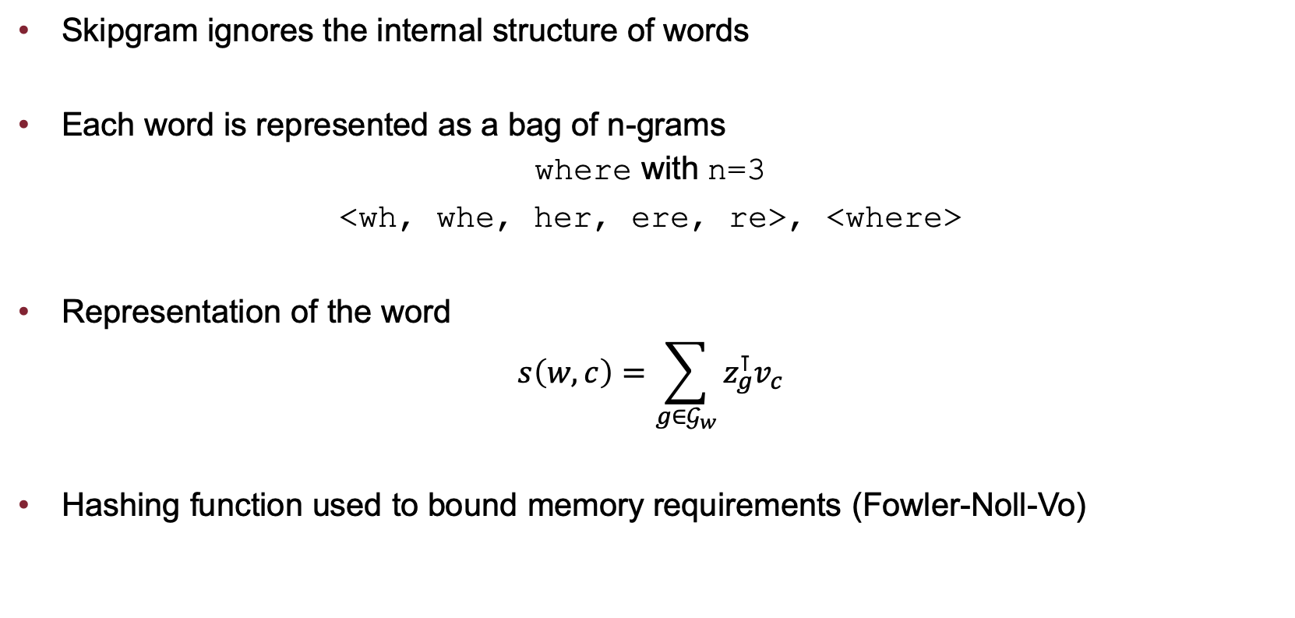
Subword model
Skipgram ignores the internal structure of words
Each word is represented as a bag of n-grams
where with n=3
<wh, whe, her, ere, re>, <where>
Representation of the word
$$s\left(w, c\right)=\sum_{g∈𝒢_{w}}{z_{g}^{⊺}v_{c}}$$
Hashing function used to bound memory requirements (Fowler-Noll-Vo)

Slide 7
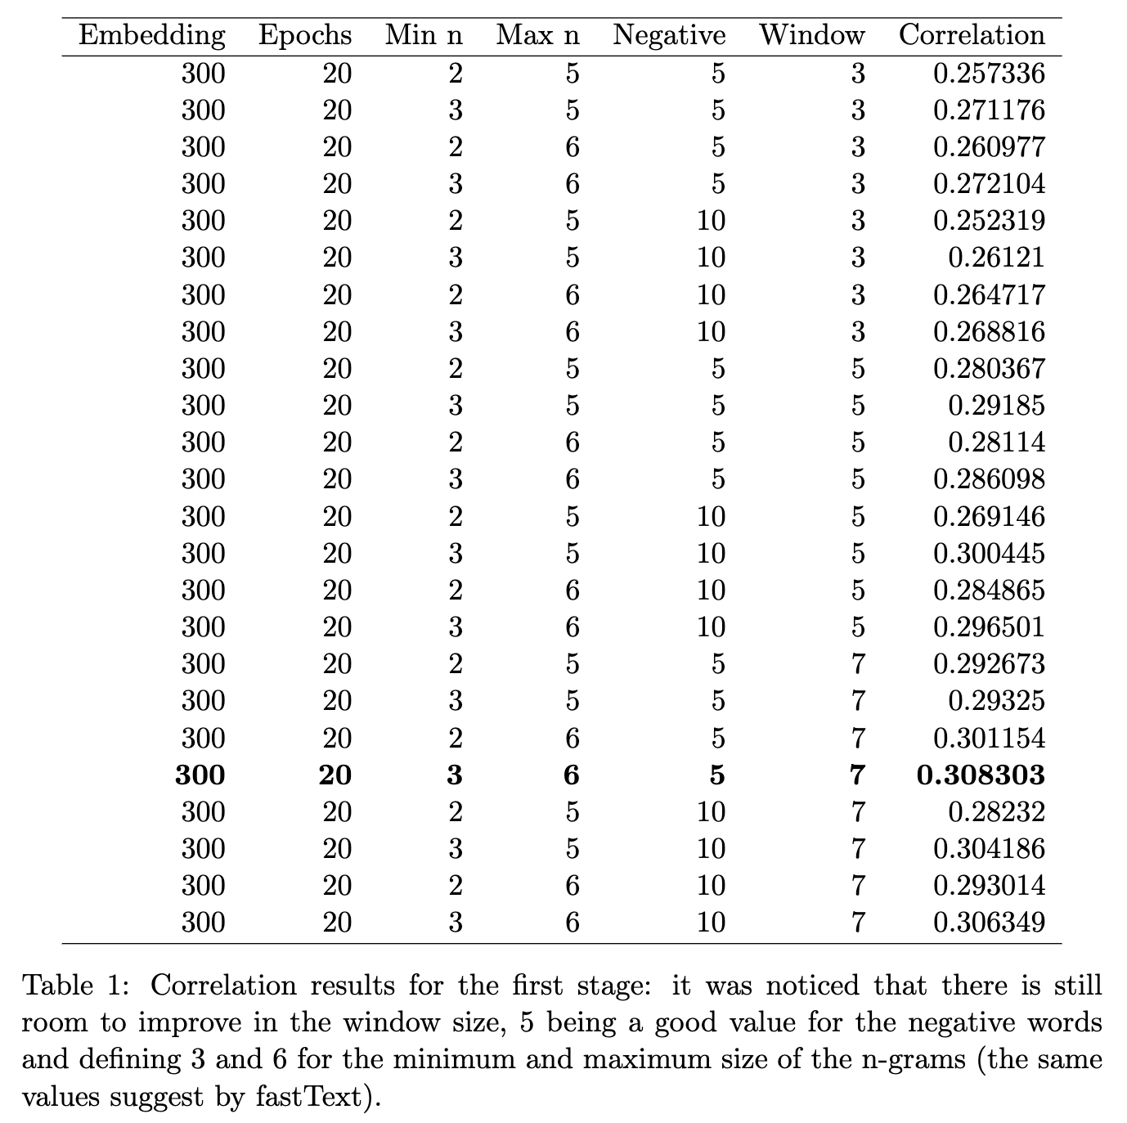
Results

Slide 8
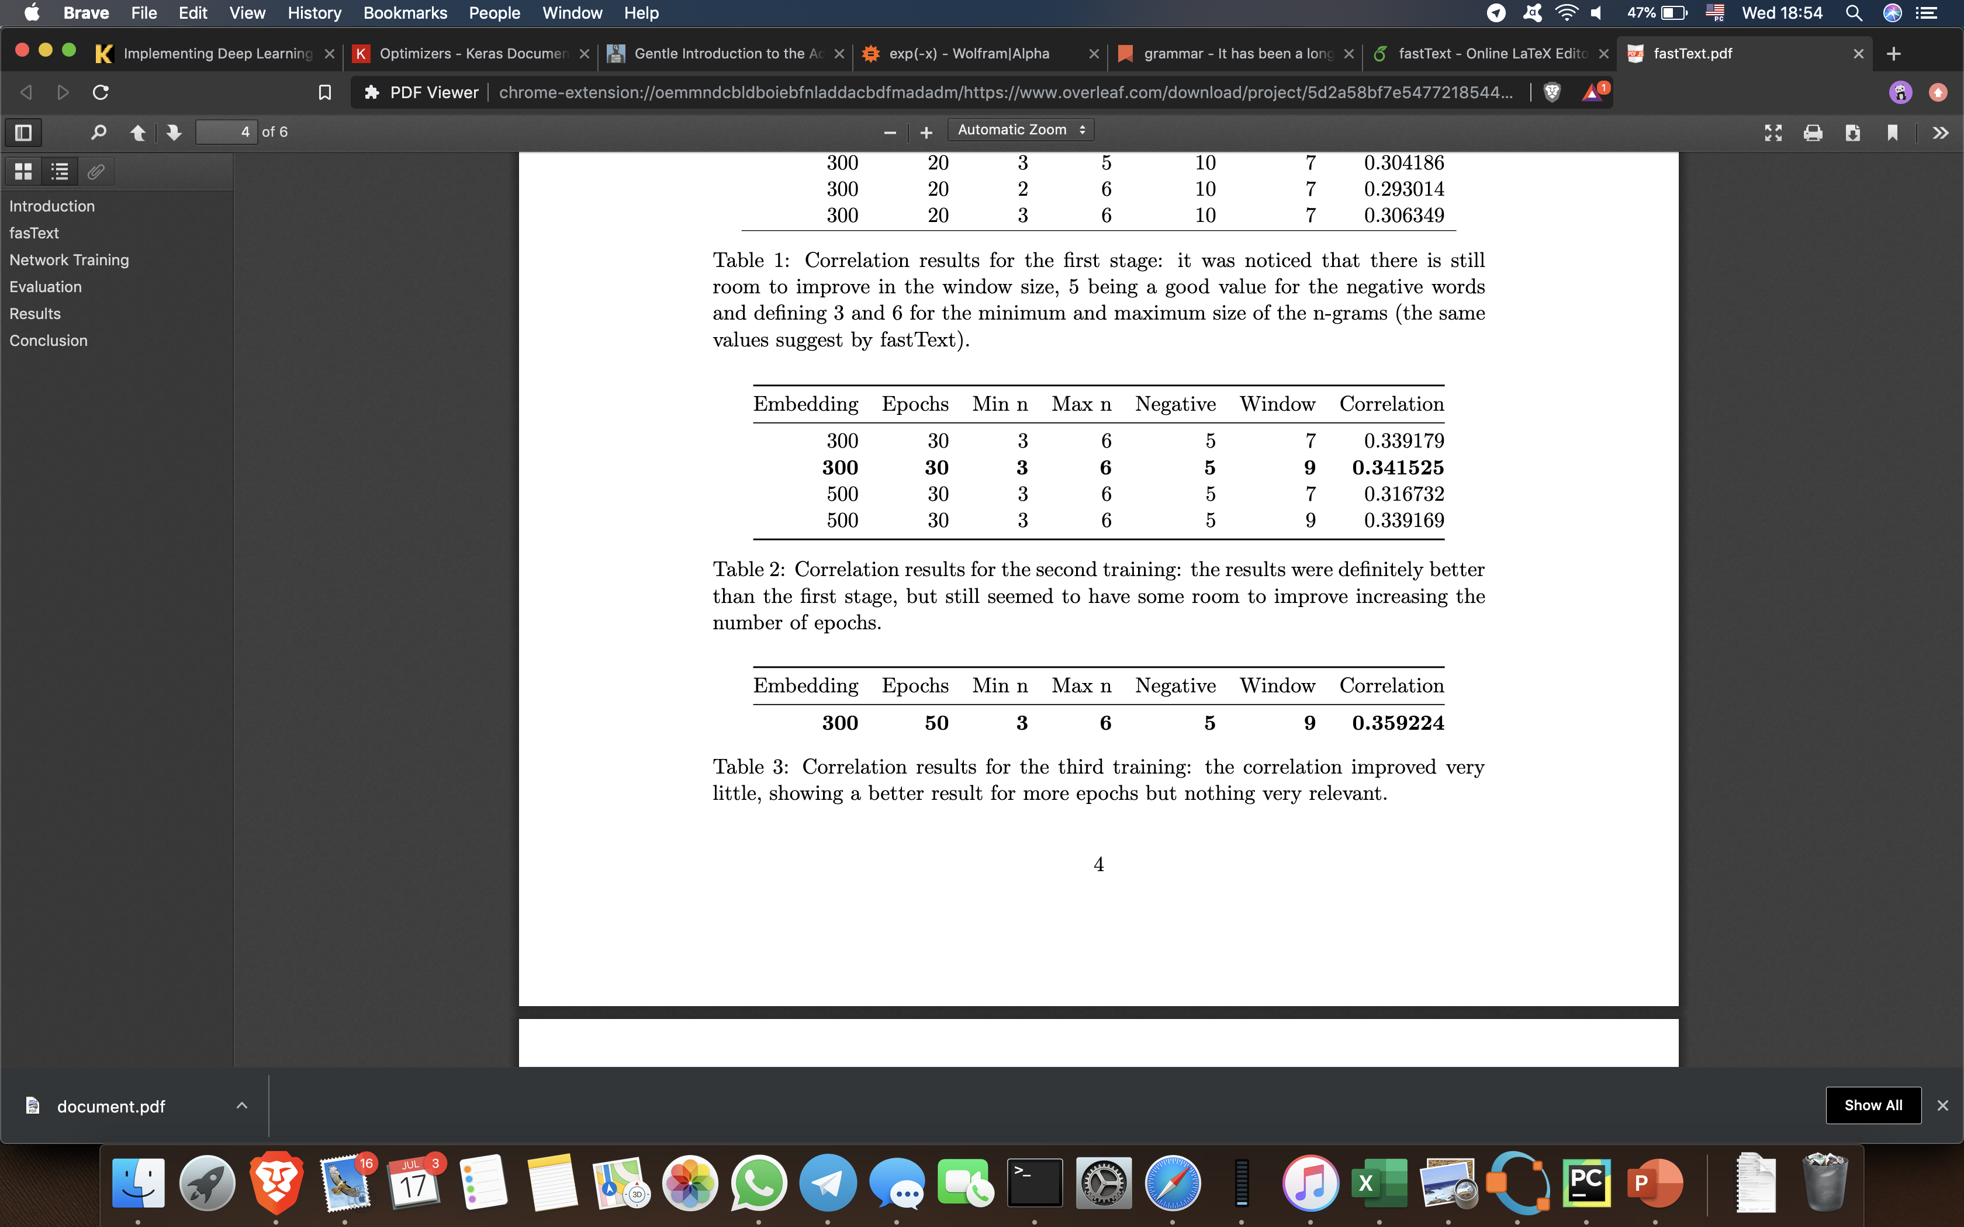
Results

Slide 9
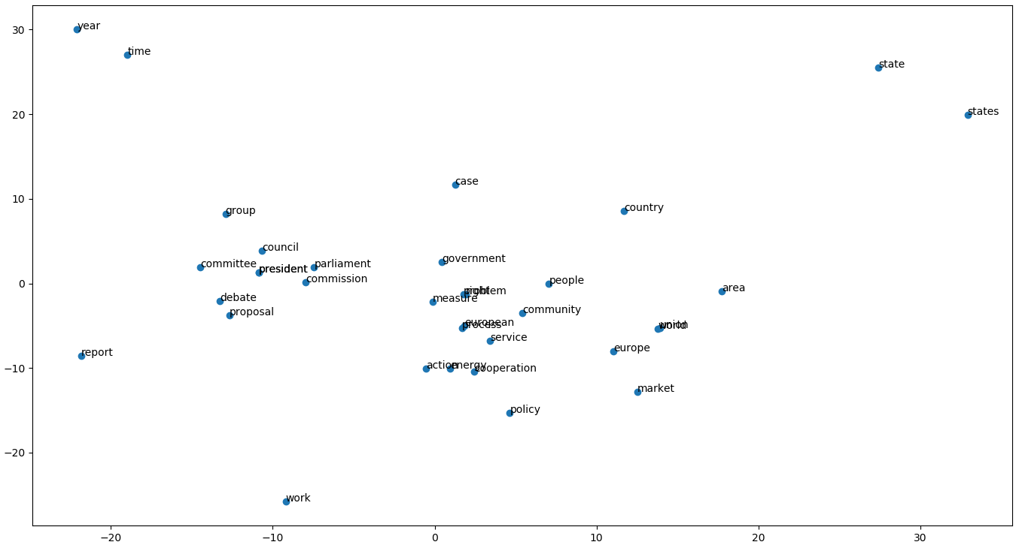
PCA
Figure 1: Dimensionality reduction of 40 words with the highest number of samples.

Slide 10
Questions?

